Slide 1



fullstackdatascience.com
Lesson 7 - Introduction to Business Intelligence & Power BI
Essential Tools for Data Analysis
Created by Huydata
DA K6
Lesson 3
huynt@fullstackdatascience.com
1

Slide 2

Learn
About
01/
Introduction to
Business Intelligence
02/
Introduction to Power BI
03/
Create your first dashboard that support decision-making
fullstackdatascience.com
2

Slide 3

Introduction to
Business Intelligence
Business intelligence, or BI, is a technology-driven data analysis process that helps an organization's executives, managers and workers make informed business decisions
3

Slide 4
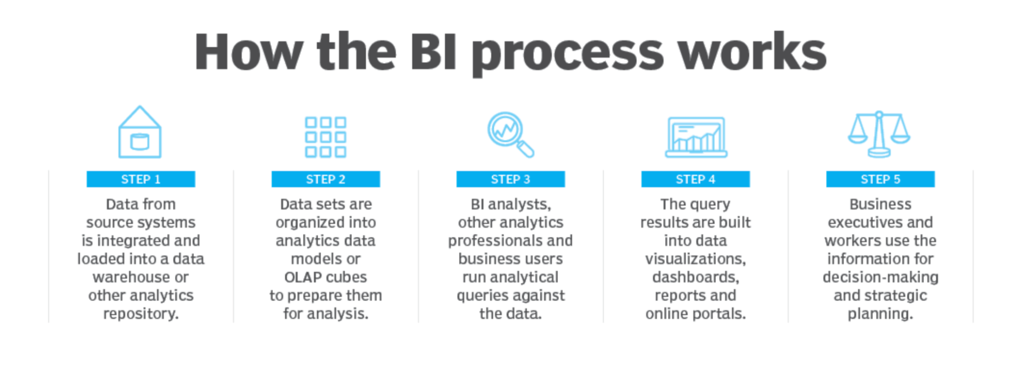
Business Intelligence Process
Process based on Data Journey (Session 1)
5

Slide 5




Business Intelligence Team
BI analyst/Data Analyst/BI Developer
Data Engineer
Data Scientist
BI Manager
5

Slide 6
Business Intelligence Tasks/Tools
Prepare Data
(SQL, Excel, Google Sheet)
Visualization
(Power BI/Tableau/Looker)
Feedback
Feedback
Analysis Data
(PowerBI/Tableau/Looker/Python/Excel/Rstudio)
Report
(Power Point/Word-Pdf file)
5

Slide 7
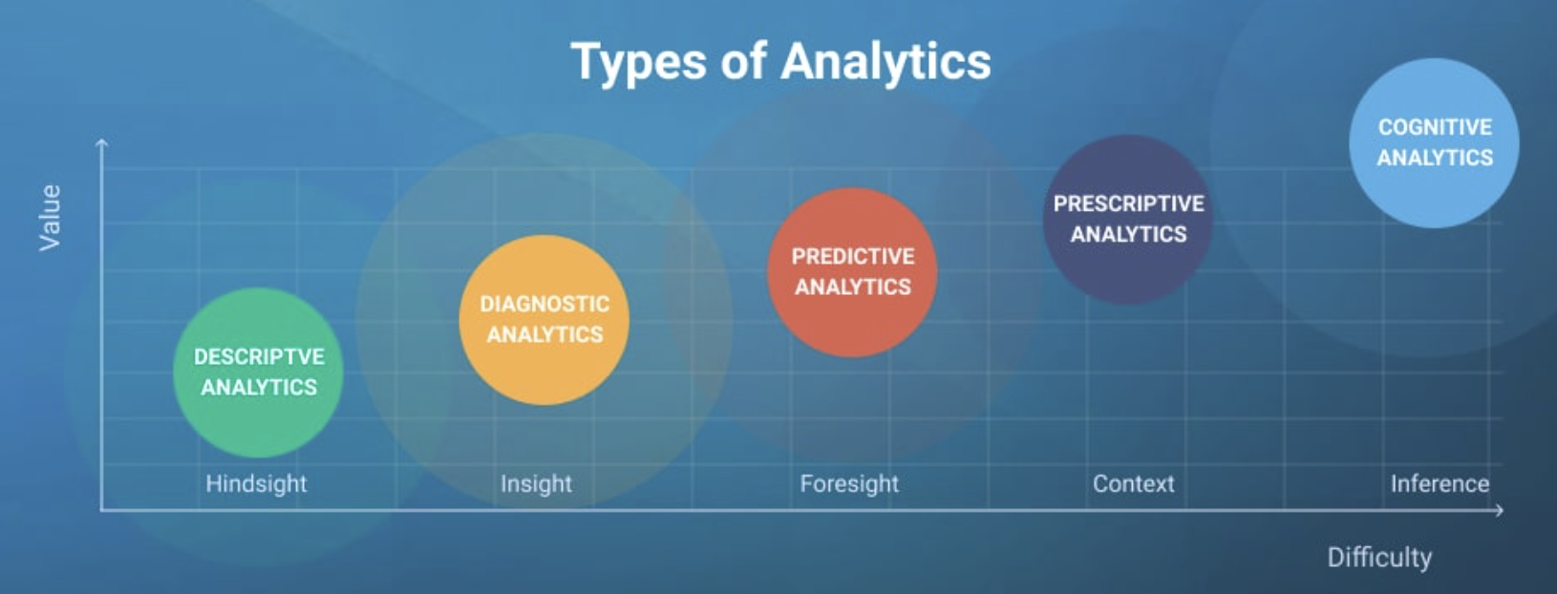
5 levels of Data Analytics
5

Slide 8
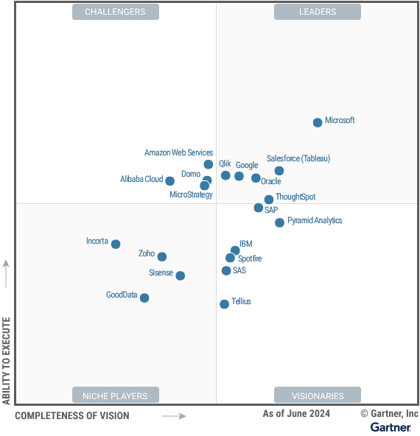
Choosing BI Tool
Power BI | Tableau
- The professional version of Power BI costs less than $10 per month/user. - Annual subscription is around $100. | - $35 per month/user - Annual subscription costs around $1000.
Power BI is cheaper than Tableau.
5

Slide 9

Introduction to
Power BI
Data visualization software that is part of the Microsoft ecosystem.
Simple, cost-effective, and user-friendly.
3

Slide 10
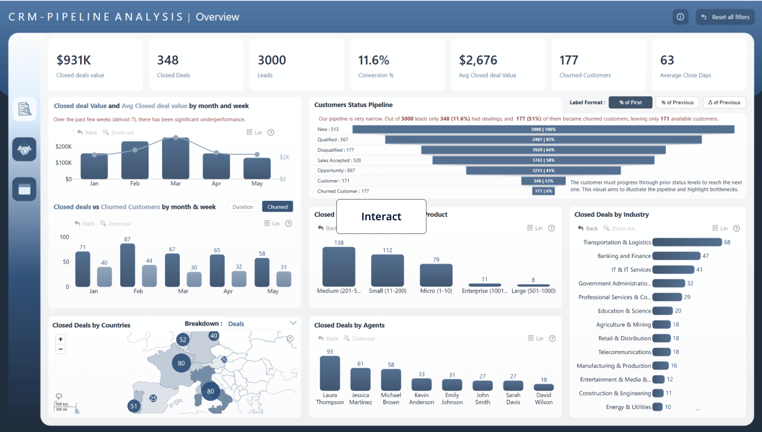
Dashboard/Report
https://zoomcharts.com/en/microsoft-power-bi-custom-visuals/dashboard-and-report-examples/
5

Slide 11
Create your first dashboard that support decision-making
Data visualization software that is part of the Microsoft ecosystem.
Simple, cost-effective, and user-friendly.
3

Slide 12
From Excel workbook to stunning report
Your manager wants to see a report on your latest sales figures. They've requested an executive summary of:
Which month and year had the most profit?
Where is the company seeing the most success (by country/region)?
Which product and segment should the company continue to invest in?
Using our sample finance workbook, we can build this report in no time. Here’s what the final report will look like.
Let’s get started!
5

Slide 13
From Excel workbook to stunning report
Business Requirements
Get data
Prepare data
Create measure (DAX)
Create table (DAX)
Layout
Visuals
Build report/dashboard
5

Slide 14
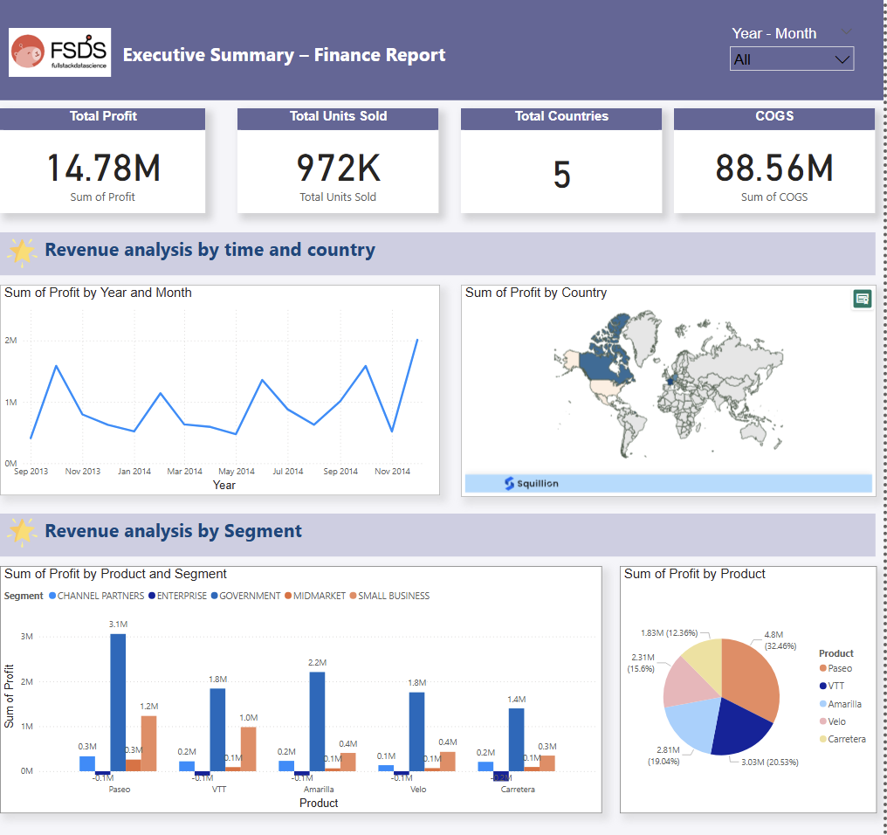
From Excel workbook to stunning report
M-QUERY
https://www.flaticon.com/
5

Slide 15

fullstackdatascience.com
References
https://cloud.google.com/bigquery/docs
https://datahubproject.io/docs/
11

Slide 16





Thank you
096 574 90 25
CREATED BY
Nguyen Tien Huy
info@robusto.ai
fullstackdatascience
huynt@fullstackdatascience.com
Data Manager
https://fullstackdatascience.com/
Hanoi, Vietnam

